Slide 1

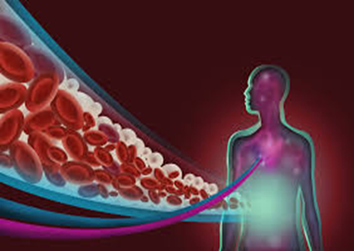
Anticoagulants and Thrombocytopenia in
Cancer patients
M. Shaheen
Hematologist
Head of hematological and BMT Department
28/06/2024

Slide 2

Cancer-associated thrombosis (CAT):
Annual incidence of VTE in the general population is 117 per 100.000
Cancer alone was associated with 4.1 fold risk
of thrombosis.
Chemotherapy increased the risk 6.5 fold
Fatal PE is 3x more common in cancer patients
than in patients without cancer
Notes:
References
Connolly GC, and Francis CW. Cancer-associated thrombosis. Hematology 2013(1):684–691.
Elyamany G, Alzahrani AM, Bukhary E. Cancer-associated thrombosis: an overview. Clin Med Insights Oncol 2014;8:129–137.

Slide 3
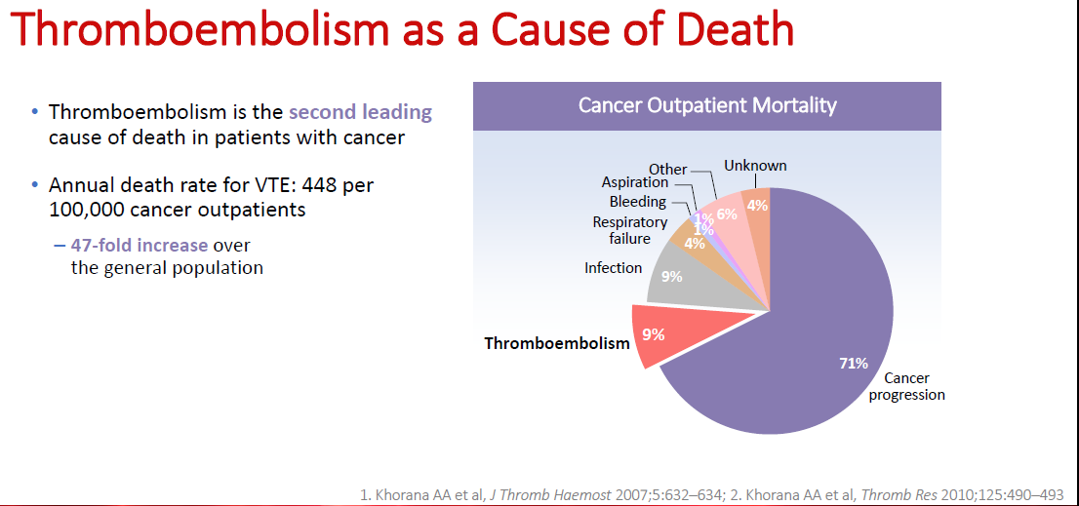

Slide 4
Risk factors for VTE in cancer
Increased risk varies from 1 – 30% depending on:
Patient characteristics | Cancer-related factors | Treatment-related factors
Female gender Older age Race (black ethnicity) Previous VTE Common comorbidities, e.g. diabetes, obesity, inflammation, pulmonary disease, renal disease, others Genetic mutations | Site of tumour(s) Tumour histology Stage and grade Initial period after diagnosis Duration of cancer | Major surgery Hospitalization Immobilization Chemotherapy Radiation therapy Erythropoiesis-stimulating agents Antiangiogenic agents Indwelling central catheters
Notes:
There are many risk factors that can increase the incidence of VTE in people with cancer. Patient characteristics, factors related to the cancer itself, and treatment-related factors have implications in risk of VTE in cancer patients.
In addition to factors noted in the chart, the presence of tumour cells induces a hypercoagulable state. Platelet and leukocyte counts and tissue factor (TF) are associated with high risk of VTE in cancer patients.
The risk of VTE is approximately 12- to 17-fold increased for patients with cancer who have the factor V Leiden or the prothrombin 20210A mutation.
References
Elyamany G, Alzahrani AM, Bukhary E. Cancer-associated thrombosis: an overview. Clin Med Insights Oncol 2014;8:129–137.
Blom JW, Doggen CJM, Osanto S, et al. Malignancies, prothrombotic mutations, and the risk of venous thrombosis. JAMA 2005;9;293(6):715–722.

Slide 5
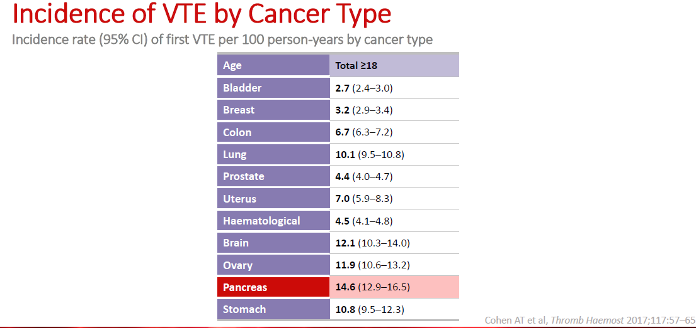

Slide 6
Some anticancer treatments are associated with increased thrombotic risk and may generate interactions affecting the effectiveness or safety of antithrombotic drugs.
the European Hematology Association in collaboration with the European Society of Cardiology has produced this scientific document to provide a clinical practice guideline to help clinicians in the management of patients with cancer and thrombocytopenia.

Slide 7
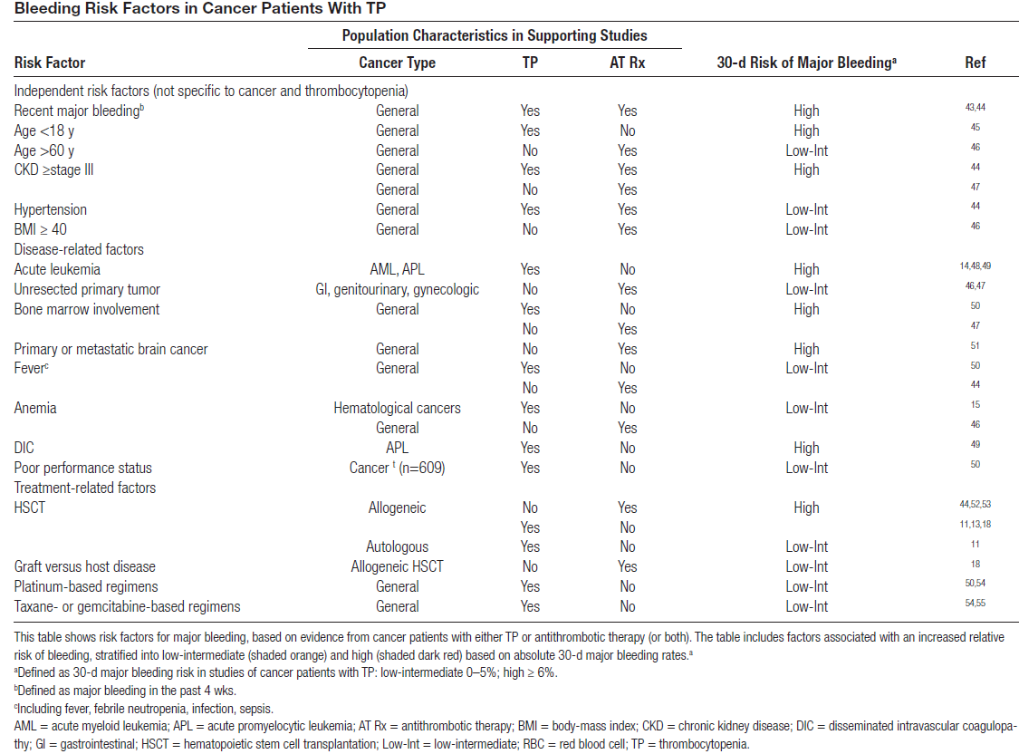

Slide 8
1-General recommendations for all antithrombotic regimens in cancer patients with TP
In all patients on single or combined antithrombotic drugs, we advise against the use of traditional NSAIDs and high doses of aspirin (≥300 mg) as analgesic or antipyretic drugs. Level 1, grade A
In all patients on single or combined antithrombotic drugs, we recommend using PPIs to prevent GI bleeding. Level 1, grade A
Among patients receiving clopidogrel, omeprazole and esomeprazole are not recommended, and pantoprazole must be considered instead. Level 1, grade A

Slide 9
1-General recommendations for all antithrombotic regimens in cancer patients with TP
Clinically relevant drug-drug interactions (DDIs) should be always considered, especially for clopidogrel, ticagrelor, warfarin, and dabigatran . Level 1, grade D
In all patients at high/very-high CV risk, we advise to always optimize the treatment of modifiable CV or cardioembolic risk factors including hypertension and hypercholesterolemia. Level 5, grade D
Platelet function monitoring is not recommended to guide single or dual APT. Level 1, gradeA

Slide 10
2-Monitoring platelet counts in outpatients receiving antithrombotic and anticancer therapy
For patients receiving antithrombotic drugs who have a moderate-high risk of developing grade 3–4 TP because of active anticancer therapy, we recommend measuring platelet count near the anticipated platelet count nadir. Level 5, grade D
If no TP is identified within the first 3 chemotherapy cycles, we recommend against further monitoring. Level 5, grade D
For grade 1–2 TP, platelet count should be rechecked within 1–2 days. Level 5, grade D
For grade 3–4 TP, antithrombotic management should be managed according to specific recommendations. Level 5, grade D

Slide 11
4. Use of TPO-RA (eltrombopag, romiplostin, avatrombopag and lusutrombopag)
Grade 3–4 TP:
TPO-RA may be used in patients with anticipated long duration of TP, providing that the patient does not have high-thrombotic risk, acute leukemia, MDS, or extensive bone marrow infiltration. Level 5, grade C

Slide 12
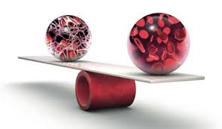
5. Management of therapeutic dose of oral and parenteral anticoagulation
Grade 1–2 TP:
We recommend therapeutic-dose parenteral or oral anticoagulation according to the approved indications after a careful evaluation of bleeding and thrombotic risk in the individual patient. Level 2b, grade C
In patients with grade 1–2 TP, which is not stable* and acute VTE, LMWH should be preferred over DOACs and VKAs. Level 5, grade D
In patients with grade 1–2 TP, which is not stable* and AF or mechanical heart valves, LMWH may be a temporary short-term option. Level 5, grade D
Stable grade 1-2 TP is defined as platelet counts which are not
expected to decrease to grade 3-4 TP in the coming days to weeks

Slide 13
Grade 3 TP:a
We recommend against using DOACs and VKAs for VTE and AF. Level 5, grade D
LMWH, at doses either prophylactic or therapeutic reduced by 50%, should be used in patients with acute VTE, after balancing bleeding and thrombosis risk. Level 2b, grade C
We recommend for holding ongoing anticoagulation in patients with AF if a short TP duration is expected, unless the patient is at very-high-thrombotic risk** or with additional cancer-related risk factors. Level 4, grade C
** AF with arterial thromboembolism in the past 3 months; AF with CHA2DS2-VASc
≥6; mechanical heart valves where full-dose anticoagulation was not possible.

Slide 14
Grade 3 TP: b
Therapeutic LMWH dose reduced by 50% with close monitoring of platelet counts may be considered in patients, with stable grade 3 TP lasting weeks to months, at very-high-thrombotic risk**. Level 5, grade D
In patients with stable platelet counts of 40–50 × 109/L and a mechanical heart valve, VKA should be considered, with a target INR of 2. Level 5, grade C
In patients with mechanical heart valve and platelet count 25–40 × 109/L or unstable INR, therapeutic LMWH dose reduced by 50% may be considered. Level 5, grade C
** AF with arterial thromboembolism in the past 3 months; AF with CHA2DS2-VASc
≥6; mechanical heart valves where full-dose anticoagulation was not possible.

Slide 15
Grade 4 TP: We recommend holding anticoagulant drugs for all the indications. Level 2b, grade C
Grade 3–4 TP: In case of very-high-thrombotic risk, we suggest continuing anticoagulation and increase platelet counts by platelet transfusion or use of TPO-RA. Level 5, grade D
We recommend resuming the appropriate dose of anticoagulation as soon as platelet count allows. Level 2b, grade B

Slide 16

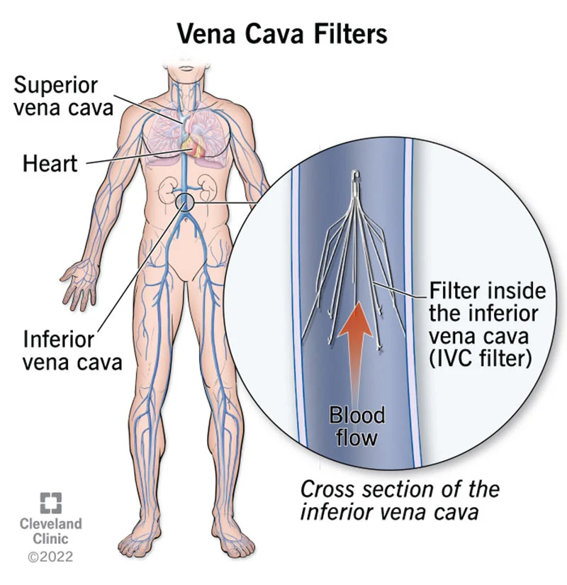
6. Device use when therapeutic-dose anticoagulation is held

Slide 17
6. Device use when therapeutic-dose anticoagulation is held
IVCF in patients with PE or lower extremity DVT:
Removable IVCF may be considered on an individual basis in patients with acute PE or acute lower extremity DVT, up to 30 days thereafter. Level 2b, grade B
We recommend periodically reassessing the removal of IVCF and removing it whenever possible. Level 2b, grade C
The contraindication for anticoagulation should be frequently (eg, weekly) reassessed in patients with IVCF. Anticoagulation should be restarted when the severe bleeding risk and TP resolve. Level 5, grade D
IVCF are not recommended starting 30 days after VTE. Level 5, grade D
IVCF are not recommended for primary VTE prophylaxis. Level 5, grade D

Slide 18
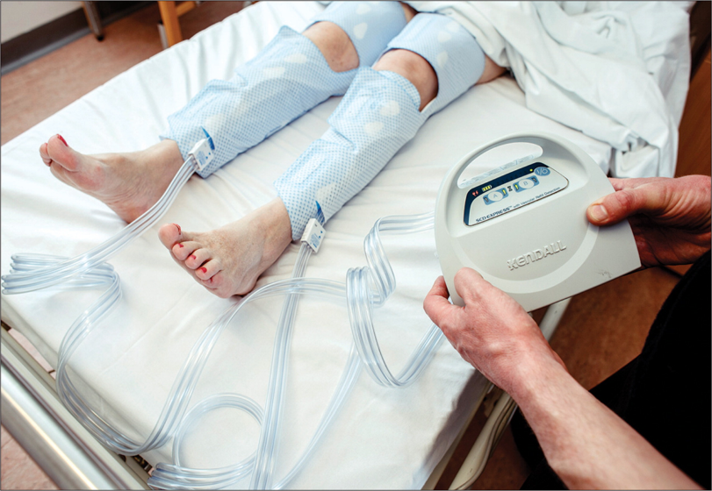
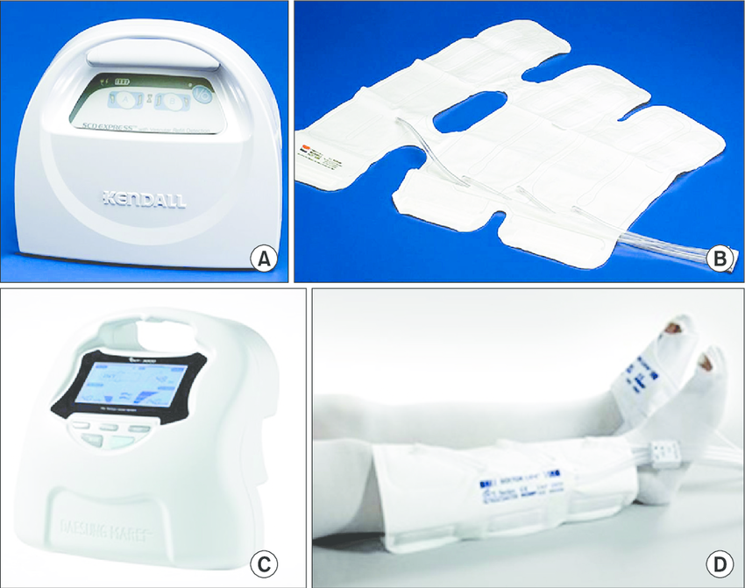
Elastic or pneumatic compression:
Intermittent pneumatic compression devices or graduated compression stockings may be considered in patients with an indication for secondary VTE prophylaxis in the absence of acute DVT, until anticoagulation can be initiated. Level 5, grade D

Slide 19
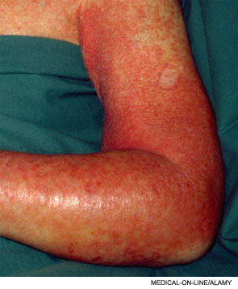
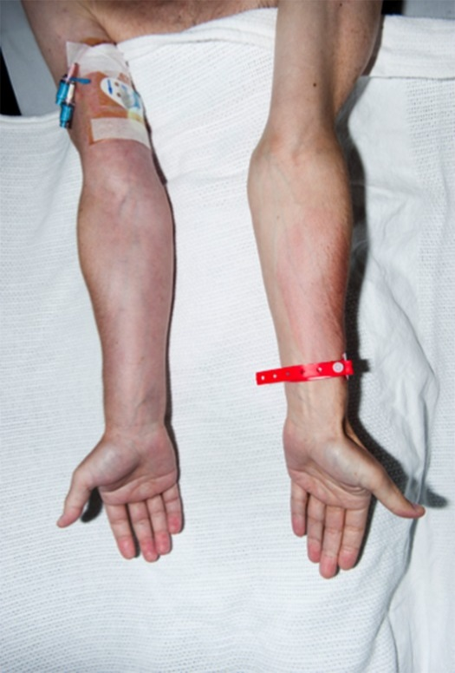
CVC removal in catheter-related UE-DVT:
Removal of the CVC is recommended in patients who cannot receive anticoagulation, within the first 30 days of an acute UEDVT. Level 4, grade C
If the CVC is essential for patient care, the feasibility of placing a CVC in the other upper extremity should be assessed. Level 5, grade D
For patients who have CVC removed after <3 months of
anticoagulation, full-dose anticoagulation is recommended
as soon as platelet count reaches ≥50 × 109/L. Level 5, grade D

Slide 20
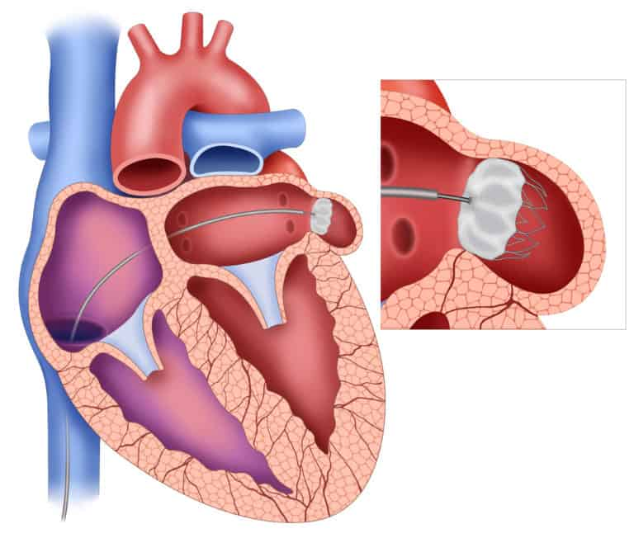
Left atrial appendage occlusion(LAAO)
LAAO in patients with AF:
LAAO may be considered in patients with
AF and TP fulfilling all of the following:
• Long-term grade 3–4 TP (at least 3 mo)
• CHA2DS2-VASc score ≥4
• No contraindication to low-dose aspirin for at least 2–4 wks after LAAO. Level 4, grade C

Slide 21

Left atrial appendage occlusion(LAAO)
Antiplatelet therapy after LAAO:
1. Grade 1–2 TP: DAPT for 6 months, then long term aspirin. Level 5, grade D
2. Grade 3 TP: Long-term low-dose aspirin. If platelets ~40 to 50 × 109/L, consider DAPT for at least 1 month. Level 5, grade D
3. Grade 4 TP: 2–4 wks of aspirin for platelet 20–25 × 109/L. Otherwise, no APT. Level 5, grade D

Slide 22
7. Prophylaxis of venous thromboembolism
Grade 1–2 TP: Standard prophylactic dose LMWH or standard prophylactic dose of apixaban or rivaroxaban should be used according to the current indications. Level 4, grade C
Grade 3 TP: Standard prophylactic dose LMWH, not DOACs may be considered in the absence of additional bleeding risk factors and if platelet counts are stable* or can be monitored closely. Level 5, grade D
Grade 4 TP: We recommend against any pharmacological VTE prophylaxis. Level 5, grade D

Slide 23
9. Low-dose aspirin in primary prevention
Grade 1 TP: we recommend maintaining SAPT with low-dose aspirin, if indicated, unless other bleeding risk factors are present. Level 5, grade D
Grade ≥2: we recommend holding SAPT and resuming as soon as platelet count is ≥75 × 109/L. Level 5, grade D

Slide 24
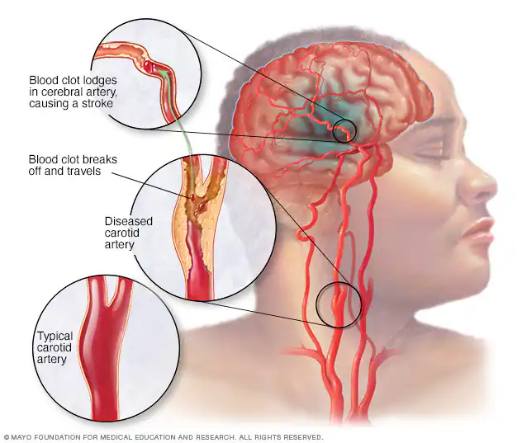
10. AIS or TIA in the past month without a significant intracranial arterial lesion
For stable grade 1 TP, DAPT with clopidogrel should be used for 21 days after the event followed by low dose aspirin only. Level 5, grade D
For grade 2 TP, DAPT with clopidogrel should be used for 21 days followed by low-dose aspirin only, unless additional bleeding risk factors are present . If additional bleeding risk factors are present SAPT with aspirin should be considered instead of DAPT. Level 5, grade D
For grade 3 TP, SAPT with low-dose aspirin should be
used. Level 5, grade D
For grade 4 TP, We recommend to withhold any APT
until platelets reach > 25 × 109/L. Level 5, grade D

Slide 25
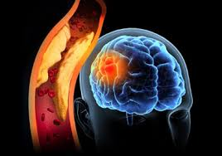
11. Acute symptomatic intracranial arterial stenosis
Grade 1–2 TP: we recommend DAPT-clopidogrel for up to 90 days. Level 5, grade D
Grade 3 TP: DAPT with clopidogrel for up to 21 days should be used in the absence of additional bleeding risk factors. Patients not eligible for DAPT because of additional bleeding risk factors should receive SAPT with aspirin. Level 5, grade D
Grade 4 TP: We recommend to withhold DAPT and
consider starting SAPT with low-dose aspirin if
platelets >25 × 109/ L on an individual basis. Level 5, grade D

Slide 26
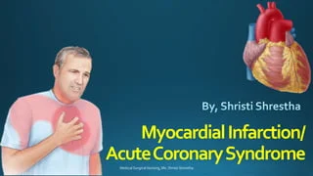
12. APT management in ACS and Post-PCI
Grade 1–4 TP: IV antiplatelet drugs (GPI, P2Y12 inhibitors)
are not recommended. Level 5, grade D
Grade 1 TP: We recommend DAPT with clopidogrel in patients with ACS within the previous 12 months, unless high-risk thrombotic factors are present, in the absence of major additional bleeding risk factors. Level 3b, grade C
Grade 2–4 TP: We recommend against DAPT with ticagrelor or prasugrel. Level 5, grade D
Grade 2: We recommend using DAPT with clopidogrel. Level 3b, grade C

Slide 27
13. Management of combined APT and full dose OAC
Grade 1–2 TP: In stable grade 1 TP, combined SAPT and OAC should be considered in patients with AF or VTE within 3 months from 1 month after ACS or 1 wk after coronary revascularization for CCS. Level 5, grade D
Grade 1–2 TP: In patients receiving OAC for AF or post-VTE, and SAPT for a non-acute, chronic indication such as PCI or CABG >1 year earlier or CAD not requiring revascularization, SAPT should be withdrawn and OAC should be managed according to the indication as detailed in recommendation. Level 5, grade D

Slide 28
Grade 3 TP: Combined SAPT and OAC are not recommended and patients should maintain SAPT with low-dose aspirin. Level 5, grade D
Grade 4 TP: Combined SAPT and OAC are not recommended. SAPT with low-dose aspirin may be considered in very-high-thrombotic risk events and platelet counts above 10 × 109/L. Level 5, grade D
Grade 4 TP: We recommend against coronary intervention. Level 5, grade D

Slide 29
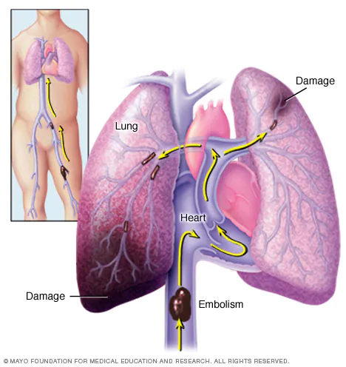
16. Reperfusion therapy for patients with PE
For grade 1–4 TP: we recommend against systemic
thrombolysis in VTE patients caused by unknown
efficacy and potentially high-bleeding risk. Level 5, grade D
For grade 1–3 TP: patients with high-risk PE and in centers with appropriate expertise systemic thrombolysis may be considered on a case-by-case basis. Level 5, grade D
For grade 1–4 TP: interventional procedures of thrombus removal including catheter-based thrombolysis or pharmacomechanical catheter-directed reperfusion techniques may be considered on a case-by-case basis with a specialist owing adequate interventional expertise of centers with appropriate experience. Level 5, grade D

Slide 30
We advise the following general approach toward all antithrombotic regimens in cancer patients with TP:
To reassess the indication of the antithrombotic therapy, irrespective of TP.
To assess the ongoing associated thrombotic and bleeding risks by identifying generic and cancer-specific factors
To anticipate the duration of grade 3–4 TP.
To formulate a clear antithrombotic therapy management plan, to be reassessed frequently according to the individual treatment plan, kinetics of TP and possible complications or comorbidities.
To consider restarting antithrombotic therapy, once the platelet count is consistently above a threshold deemed suitable for full antithrombotic medication, as indicated in each section.

Slide 31
Thrombosis in ITP
Annual incidence of VTE in ITP /100 person of approximately 0.41–0.67, compared with 0.28–0.42 in the general population
For arterial events in ITP patients has been calculated at 0.96– 1.15 compared with 0.67–0.91 for the general population.
Thrombosis risk is multifactorial. ITP-related factors include increased levels of immature hyperactive platelets, circulating MKs, prothrombotic MPs, altered VWF activity and possible effects of autoantibodies on endothelial surfaces.
2021 British Society for Haematology and John Wiley & Sons Ltd British Journal of Haematology, 2021, 194, 822–834

Slide 32
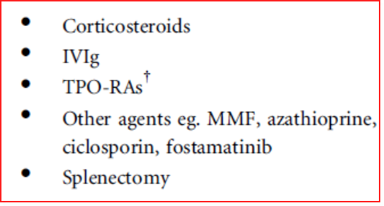

Slide 34


THANK YOU
FOR YOUR ATTENTION

